Slide 1
Walsall Family Hubs Timetable of activities between
October – December 2024
A full timetable of our events, plus the locations of our 4 locality Hubs can be found on the Family Hubs website: https://www.walsallfamilyhubs.co.uk/find-activity#main and follow us on Facebook (walsallfamiliesintheknow)

Slide 2
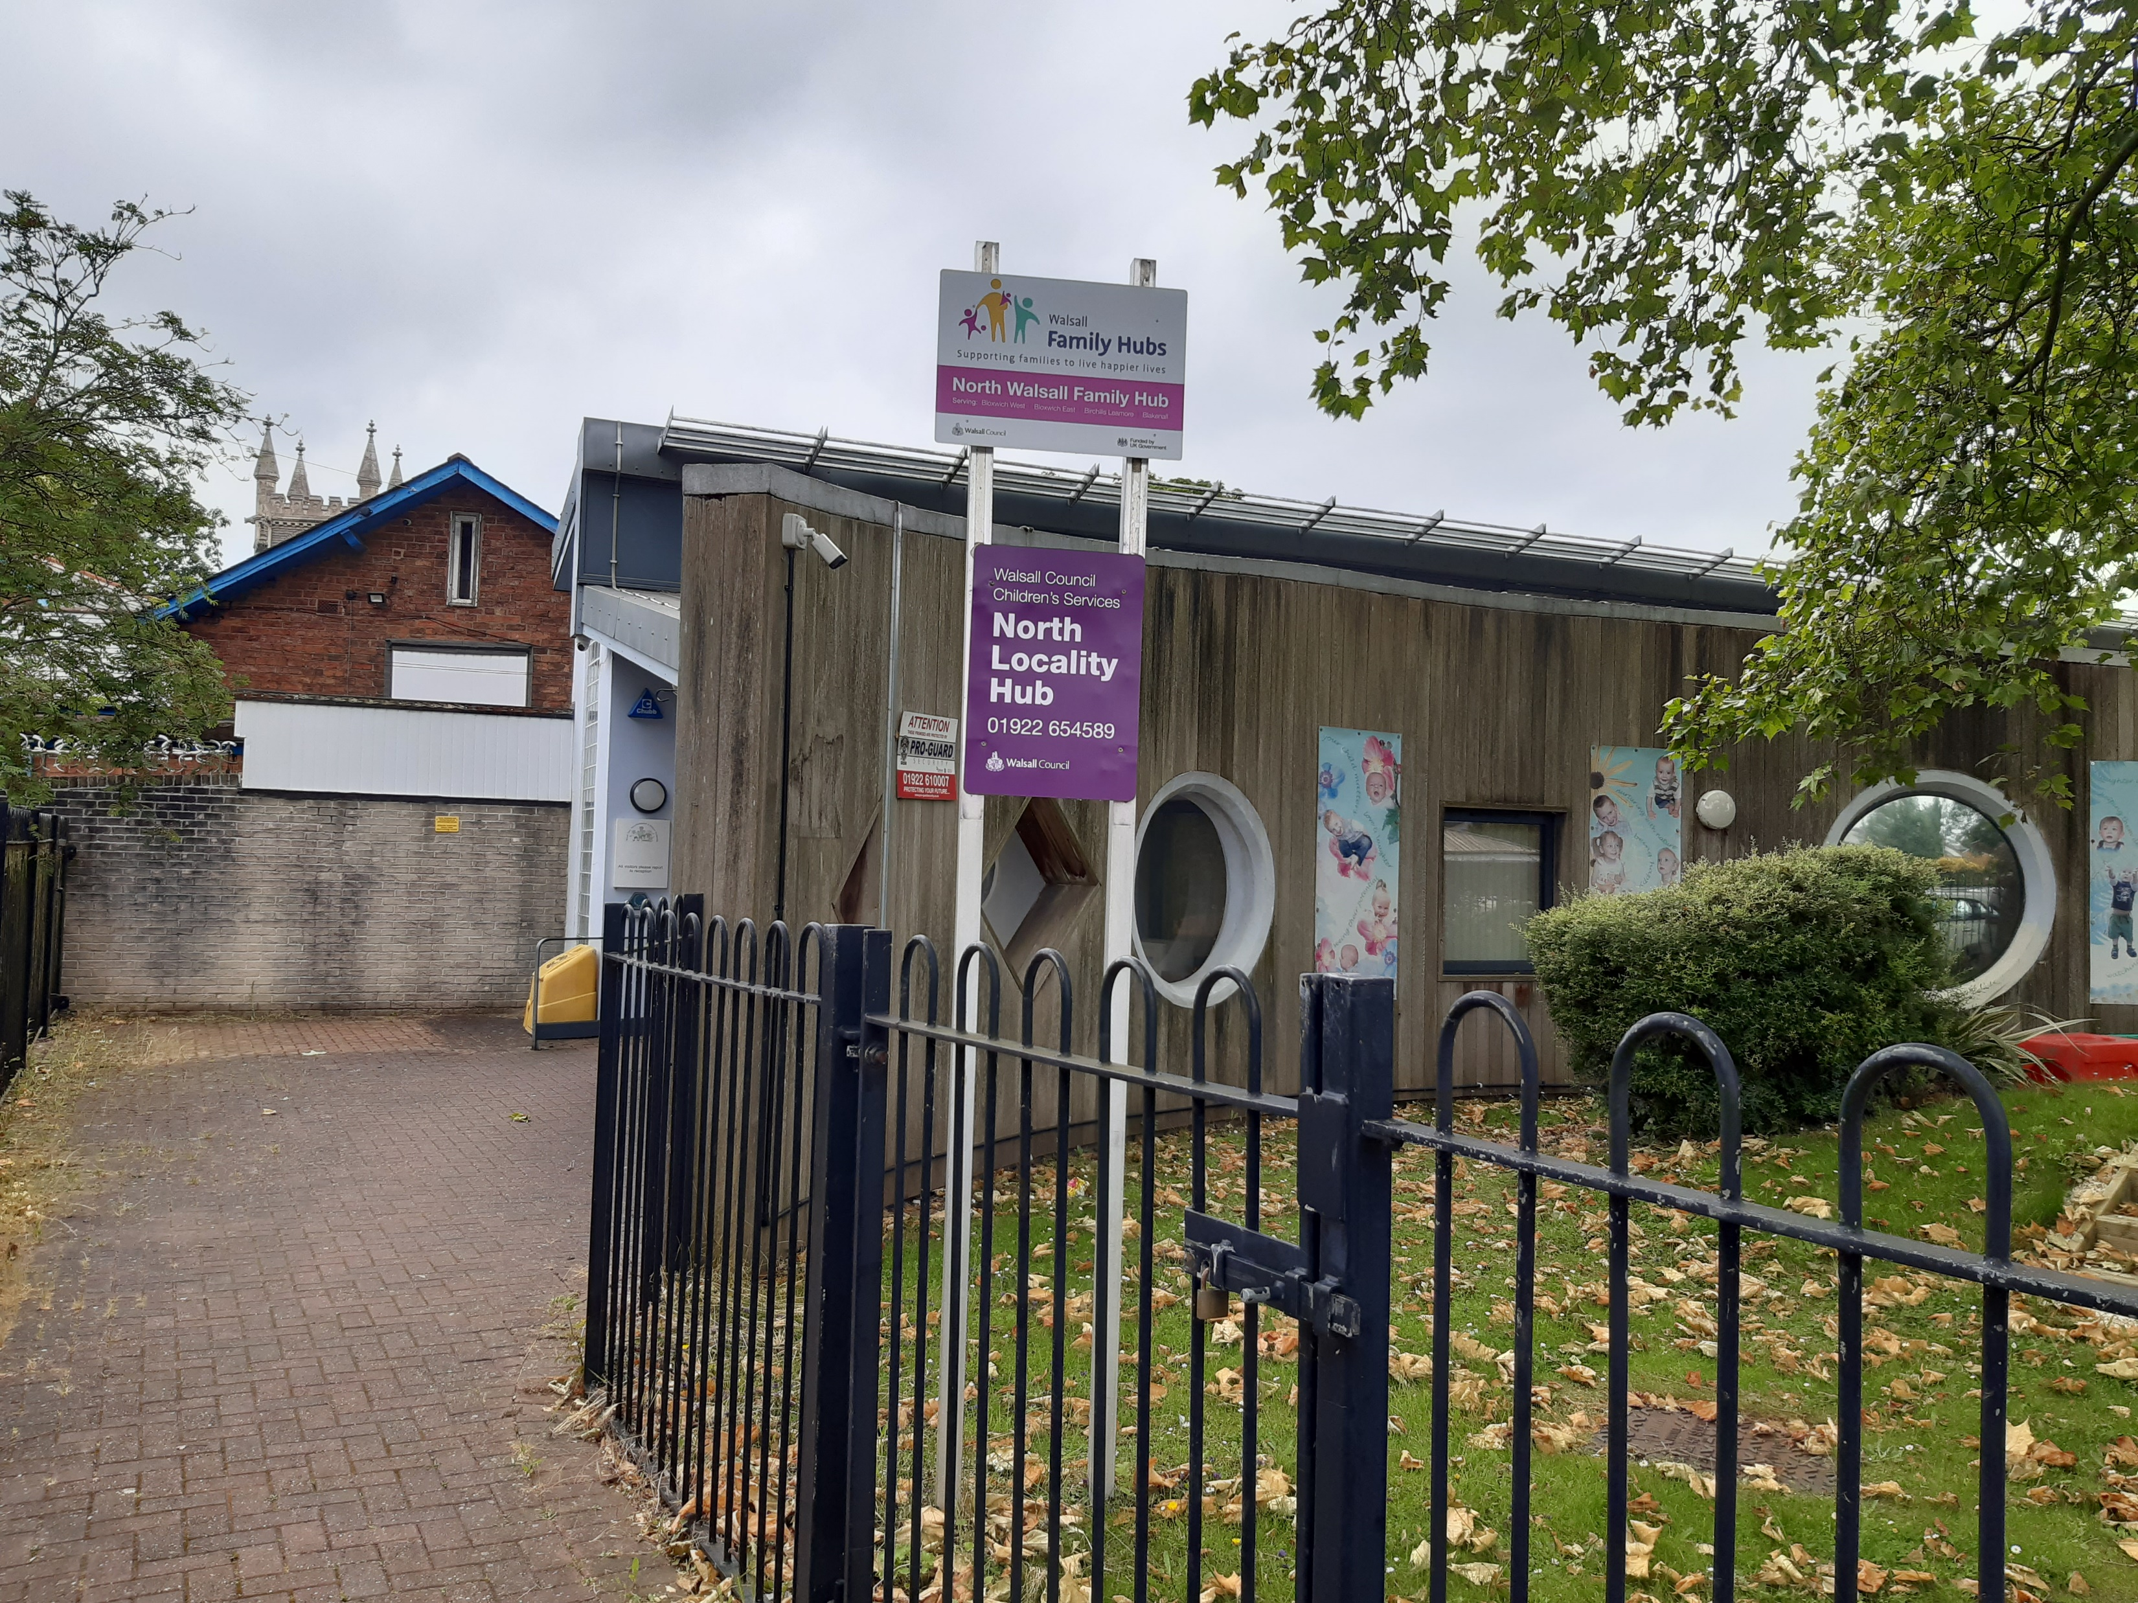



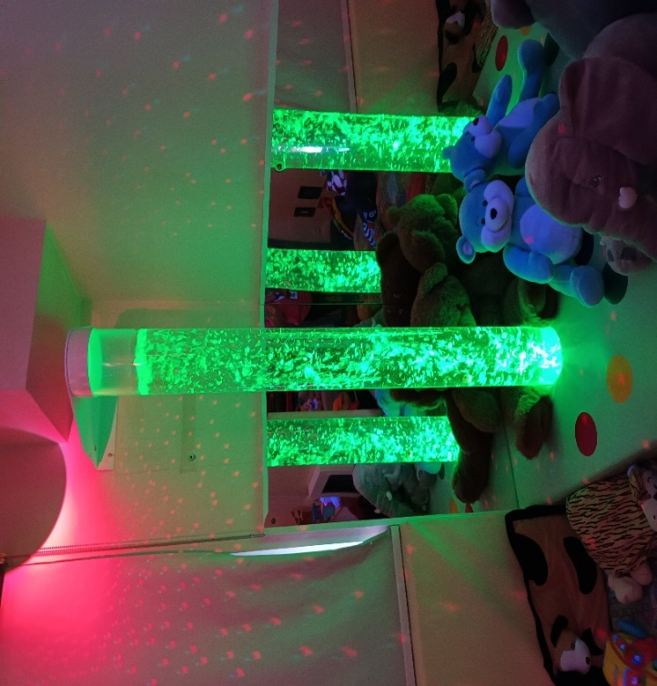
North Activity Timetable for 0 – 5 years
Serving; Leamore, Blakenall, Bloxwich East & Bloxwich West
October – December 2024
** Always contact groups before attending in case of any changes
Monday | Tuesday | Wednesday | Thursday | Friday | Saturday
11.30 – 1:00 Toddler Splash @ Bloxwich Active Living Centre, High St, Bloxwich, Walsall WS3 2DA - £5.50 per adult and child, Call 01922652900 to book your place 09:45- 11:45 Starlight Multi Care and Sensory Stay and Play @ 25a Station Street, Walsall, WS2 9JZ, £4 per child, plus £2 for every extra child- www.starlightmulticare.com 9.30-11.30am PEEP antenatal workshop @ Ryecroft Community Hub 28, New Forest Rd, WS3 1TR - PEEP. Please email familyhubswellbeing@walsall.gov.uk to book your place. (11th November – 16th December) 11.00-12.00pm PEEP @ North Family Hub. Please email EarlyHelpParentingTeam@walsall.gov.uk to book your place (7th, 14th & 21st October , 4th,11th, 18th & 25th November ) | 11.30 – 1:30 Toddler Splash & Play @ Bloxwich Active Living Centre, High St, Bloxwich, Walsall WS3 2DA - £7 or 4.50 with a move it card Call 01922652900 to book your place 1:00-2:30pm Don't Slam That Door @ Ryecroft Community Hub, New Forest Rd, WS3 1TR. Please email EarlyHelpParentingTeam@walsall.gov.uk to book your place (22nd October) 1:00 Introduction to solid foods to your baby @ North Family Hub. Book by emailing familyhubs@walsall.gov.uk 15:00 – 17:30 Christmas Event @ North Family Hub. Join us to celebrate Christmas. Make and take tree decorations, write your letter to Santa, even make a treat for his reindeers. Booking welcome by calling the Family Hub on 01922 654589 or simply join us on the day. (Tuesday 17th December ) | 09:30 – 2:30 Walsall Works drop in for families @ North Family Hub, WS31HJ 11.30 – 1:00 Toddler Splash @ Bloxwich Active Living Centre, High St, Bloxwich, Walsall WS3 2DA - £5.50 per adult and child, Call 01922652900 to book your place 9.30-11.30 Frankie's Parents and Tots @ Beechdale Lifelong Learning Centre, Stephenson Square, Walsall, WS2 7DY - £1 per child, No booking required (term time) 1:00pm Little Storks - A group for parents/carers and their babies to meet in a relaxed environment ( 0-12 Months) @ Family Hub, 275 Blakenall Lane, Blakenall, Walsall WS3 1HJ- To book call 01922 423252 10:00 -11.30am Halloween Event @ North Family Hub. Booking welcome by calling the Family Hub on 01922 654589 or simply join us on the day. (Wednesday 30th October) | 09:30- 11:00 St John's Methodist Church Baby & Toddler Group @ St John's Methodist Church, Victoria Avenue, Bloxwich – £2 per child, £1 per baby No booking, drop in. (0-4 yrs) 09:45- 11:45 Starlight Multi Care and Sensory Stay and Play @ 25a Station Street, Walsall, WS2 9JZ, £4 per child, plus £2 for every extra child- www.starlightmulticare.com 10:00-11:00 Baby Bounce – Free Soft Play ( Term Time Only) Parents aged 15– 25 years old. @ Hub 1, Palace Play, Shop, Eat, Blakenall Row Bloxwich, WS3 1LW Contact 07852559071 9.30-11am Chill & Chat Stay and Play @North Family Hub. No Booking required. (17th October, 14th November & 12th December) 12:30-2:00pm Parent Panel @ North Family Hub. Face to face discussion around Pathfinders Families First. Free Creche and Incentives for attending. To book your place email familyhubs@walsall.gov.uk (17th October) | 10:30 - 1.30 Splash and Play @ Bloxwich Active Living Centre, High St, Bloxwich, Walsall WS3 2DA - £7 or £4.40 with a move it card , Call 01922652900 to book your place 10:00– 11.30 St Peters Baby and Toddler @ St Peters Parish Hall, Harrison Stret, Bloxwich, WS3 3LG - £2 per session , contact Ann to book your place on 07788910467 11:00 -12.30 Breast Feeding Peer Support Group - North Family Hub, Blakenall Lane, WS3 1HJ. weekly no booking required | 2.30-3.30 Floats Fun session@Bloxwich Active Living Centre, High St, Bloxwich, Walsall WS3 2DA - £5 per person / Under 5 £3, Call 01922652900 to book 09:00-09:40 Age 2-3 & 09:40- 10:20 Age 3 – 5 yrs Kixx Football Academy @ Bloxwich Active Living Centre, High St, Bloxwich, Walsall WS3 2DA 10.00-12.00pm Dads Stay and Plays @ North Family Hub No booking required, just turn up. (5th October,2nd November & 7th December)
Did you know you can book out the sensory room at the North Family Hub?
Book by calling 01922 654589 or dropping in the centre , 275 Blakenall Lane, Blakenall, Walsall WS3 1HJ
Key – Purple - funded by Walsall Family Hubs and located in Community spoke or North Family Hub, 275 Blakenall Lane, Blakenall, Walsall WS3 1HJ
Black – Signed up to Walsall Family Hubs Directory

Slide 3
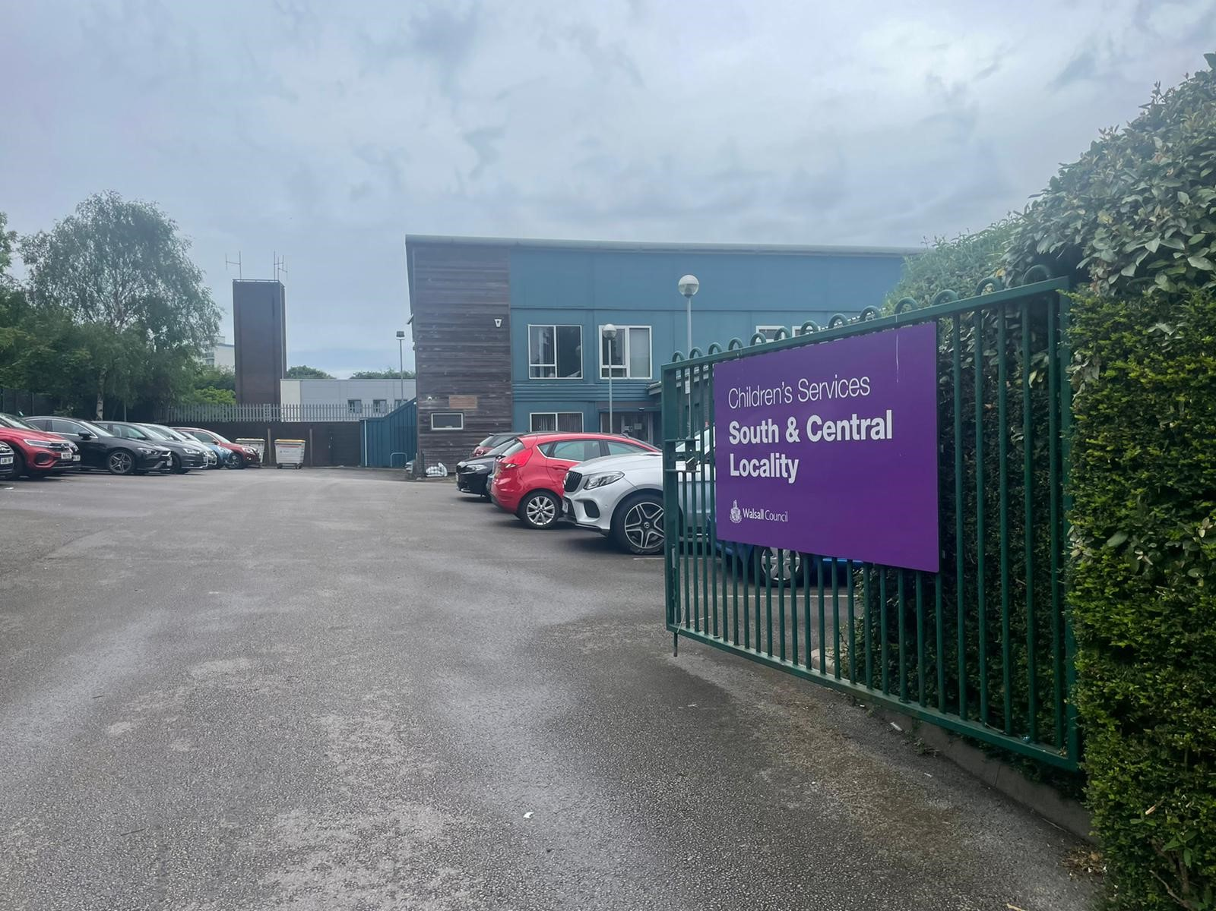
Key – Purple - funded by Walsall Family Hubs and located in Community spoke or South and Central Family Hub Birchills Street, Walsall, WS2 8NF
Black – Signed up to Walsall Family Hubs Directory
South and Central Activity Timetable for 0 – 5 years
Serving Palfrey, Pleck , Caldmore, Chuckery and
Paddock & St Matthews
October – December 2024
** Always contact groups before attending in case of any changes
Monday | Tuesday | Wednesday | Thursday | Friday | Saturday
12 – 1.30pm Toddler Splash @ Walsall Gala Baths, Tower St, Walsall WS1 1DH - £5.50 per adult and child, Call 01922653150 to book your place 09:30-11:30am @ Frankie and Lolas, Matthew's, Frankie & Lola's The Mezzanine ASDA St, George St, Walsall WS1 1RS Includes – 2 hours session with a special activity, toast for the adult, toast for the child, juice, banana, yoghurt, and a hot drink for the adult. £4. 09:45 –11:4am 5 Stay and play @ Starlight Multi Care and Sensory WS2 9JZ- £4 per child, plus £2 for every extra child. Can pay cash or card on entrance or book and pay online via www.starlightmulticare.co.uk/book-here/ 09:45am Kiddy Bops Music class @ Orchard Pavilion, Walsall King George VI Avenue, Walsall. WS5 3AH- £6 per session - Book via Our schedule | Kiddibops | Powered by ClassForKids ( 0 – pre walkers) 10 :40am Kiddibops SEND Music Support Class @ Orchard Pavilion, Walsall King George VI Avenue, Walsall. WS5 3AH- £7 per session - Book via Our schedule | Kiddibops | Powered by ClassForKids (2 – 4 yrs) 1:00-2:00pm Join us for a walk in the park @Walsall Arboretum , Meet at Visitors centre 1:00-2:30pm Parenting My Way Session @ Central and South Family Hub. Please email EarlyHelpParentingTeam@walsall.gov.uk to book your place (1st and 7th October) 2.30-3.30-pm Grandparents Coffee and Chat @ South & Central Family Hub. Please email EarlyHelpParentingTeam@walsall.gov.uk to book your place. (18th November) | 2.00-3.00pm Toddler Splash @ Walsall Gala Baths, Tower St, Walsall WS1 1DH - £5.50 per adult and child, Call 01922653150 to book your place 09:30 – 2.30pm Walsall Works drop in for families @ South & Central Family Hub 1:00-2:30pm Don't Slam That Door @ Myplace, 60 Walstead Rd W, Walsall WS5 4PE. Please email EarlyHelpParentingTeam@walsall.gov.uk to book your place (12th November) | 09:30-11:30 Frankie and Lolas @ Matthew's, Frankie & Lola's The Mezzanine ASDA St, George St, Walsall WS1 1RS Includes – 2 hours session with a special activity, toast for the adult, toast for the child, juice, banana, yoghurt, and a hot drink for the adult. £4. First Aid Awareness Workshop @ Nash Dom Community Hub, Sun St, Walsall WS1 4AL​. To book your place you can email familyhubs@walsall.gov.uk ​with your name, what session you would like to book, ​your postcode and email address​ (Wednesday 6th November) . 12.00-1.30pm Dads Stay and Plays @ North Family Hub No booking required, just turn up. (23rd October, 20th November & 18th December) 10.00-11.00am PEEP @ Lichfield Street Hub – Library , Lichfield St, Walsall WS1 1TR. Please email familyhubs@walsall.gov.uk to book your place (9th, 16th , 23rd October) 09:30 – 11:00 Peep Play and Storytime - South & Central Family Hub. Wednesday 9th October, 6th November, 18t December 2024) 10:00 -11.30 Autumn Event @South Family Hub . Booking welcome by calling the Family Hub on 01922 654545 or simply join us on the day. (Wednesday 30th October 3:30- 17:00 Christmas Event @ South & Central Join us to celebrate Christmas. Booking welcome by calling the Family Hub on 01922654545 or simply join us on the day. (Wednesday 11th December | 12:00 – 1.30 Toddler Splash @ Walsall Gala Baths, Tower St, Walsall WS1 1DH - £5.50 per adult and child, Call 01922653150 to book your place 9.30 – 11 Stay and Play 0-5yrs @ St Matthew's Church Centre, St Matthew's Close, Walsall WS1 3DG - £2 per child – No booking required 09:45 –11:45 Stay and play, Starlight Multi Care and Sensory WS2 9JZ- £4 per child, plus £2 for every extra child. Can pay cash or card on entrance or book and pay online via www.starlightmulticare.co.uk/book-here/ 12.30-2:00 Sensory play for babies 0-12mnths @ St Matthew's Church Centre, St Matthew's Close, Walsall WS1 3DG - £2 per session - Contact Priscilla on 07984 626637 to book your place 10.30 – 12:00 Caldmore Tots 0-5 yrs @ Caldmore Community Garden, 12 Carless Street, Walsall, WS1 3RH – No booking required 12.00-2.00pm Dad's peer support group @ South & Central Family Hub. No booking required, just turn up. (5th and 12th December) 9.30-11.30am 0-2 yrs parent and toddler wellbeing sessions @ West Family hub. No booking required (3rd – 17th October) (21st October Fathers/Males) 9.30-11.30am Let’s talk relationships @ South and Central Hub. . Please email EarlyHelpParentingTeam@walsall.gov.uk to book your place (17th October) 12:30-2:00pm Parenting my way @ Central and South Family Hub. Please email EarlyHelpParentingTeam@walsall.gov.uk to book your place. (17th & 21st November) | 2.30 – 3.30pm Toddler Splash @ Walsall Gala Baths, Tower St, Walsall WS1 1DH - £5.50 per adult and child, Call 01922653150 to book your place 1:00pm Nature Makers @Walsall Arboretum, Broadway N, Walsall WS1 2QB. Visit https://www.nature-makers.co.uk/walsall-and-sandwell to book your place. | 11:00-1:00pm - Cubs Playgroup for children aged 0 to 5 @Nashdom,Sun Street, Walsall, WS14AL Group every 2 weeks, free session . To book call 01922616444 11:00- 1:00 Play and Stay session for Ukrainian children @Nashdom,Sun Street, Walsall, WS14AL Group every 2 weeks, free session . To book call 01922616444 09.00 - 10.30am Performing Arts for 3-6 Yrs @ Breakout Performing Arts, Blue Coat Church of England Academy, Birmingham Street, WS1 2ND Visit https://www.breakoutschool.co.uk/ to book your place 09:30-10:30 Walsall FC Saturday Club @ Poundland Bescot WS1 4SA. £20 for 5 weeks. email courtney.haynes@walsallfc.co.uk 11:00 –2:00pm Caldmore Community Garden 0 – 14 months, 12 Carless Street, Walsall WS1 3RH, to book visit http://tinyurl.com/gardensaturdays 10.30-12.00pm Stay and Play @ South and Central Family Hub. Booking welcome by calling the Family Hub on 01922 654545 or simply join us on the day. (16th November)

Slide 4
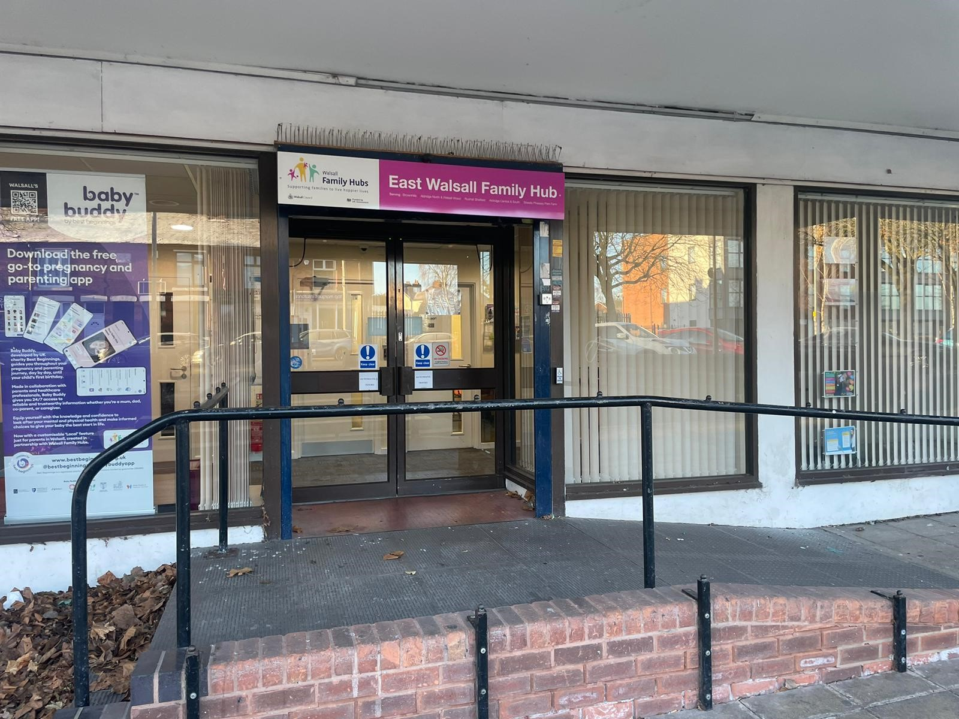
Key – Purple - funded by Walsall Family Hubs and located in Community spoke or East Family Hub , Silver Court, Walsall, WS8 6HA
Black – Signed up to Walsall Family Hubs Directory
East Activity Timetable for 0 – 5 years
Serving; Aldridge,Pelsall, Shelfield, Rushall, Brownhills, Walsall Wood, Streetly & Pheasey.
October – December 2024
** Always contact groups before attending in case of any changes
Monday | Tuesday | Wednesday | Thursday | Friday | Saturday
9:00 – 10.30am Toddler Splash @ Oak Park Living Centre, Coppice Rd, Walsall Wood, Walsall WS9 9BH- £5.50 per adult and child, Call 01922652266 to book your place 11.45 – 12.30am Little Explorers @ Pelsall Village Centre, High St, Pelsall, Walsall WS3 4LX - £8.50 per session visit www.thecreationstation.co.uk/finder to book your place (18mnth – 5yrs) 11.15 – 11.45am Rhythm Time @ Pelsall Community Centre, Station Road, Pelsall, Walsall WS3 4BQ - Visit Www.rhythmtime.net/cannock-and-pelsall to book your place (0-13 mths) 12.30 – 2:00pm Seedlings Praise @ Tynings Lane Church, 2 Tynings Ln, Walsall WS9 0AS - £2.50 donation, No booking required 1:15 – 2:45pm Ogley Hay Nursery School Stay @ Calvary Church, Brickiln St, Brownhills, Walsall WS8 6AU (0 -2yrs) 09:30- 2.30pm Walsall Works drop in for families @ East Family Hub 10:00- 4,00pm 5 senses Play and Stay @ Walsall wood hub Lichfield Road Walsall wood ws9 9np. £ 5 per child, £4 per sibling – No booking required – for more info call 07724 566961 PEEP @ Manor Farm Community Association, King George Crescent Rushall Walsall WS4 1EU. Please email familyhubs@walsall.gov.uk to book your place (2nd, 9th, 16th December) | 09:30- 10:30 Serendipity Infant and Child Wellness (baby massage) @ Stonall Community Centre, Main Street WS9 944 £55 per course, for more information and to book visit www.serendipity-wellness.co.uk (0-6 months) 09:30 – 10:15am Action Tots @ Brownhills Community Centre, Chester Rd N, Brownhills, Walsall WS8 7JS, Brownhills, Walsall, WS8 7JW - £26 per month (2-4yrs) 9:30 – 11:00am Seedlings Praise @ Tynings Lane Church, 2 Tynings Ln, WS9 0AS - £2.50 donation, No booking required 10:30 – 11:10am Social Tots @ Brownhills Community Centre, Chester Rd N, Brownhills, Walsall WS8 7JS, Brownhills, Walsall, WS8 7JW - £24 per month (8mths-3yrs) 10:30 – 11:10am Discovery Tots @ Brownhills Community Centre, Chester Rd N, Brownhills, Walsall WS8 7JS, Brownhills, Walsall, WS8 7JW - £24 per month (2-9months) 1:00- 2:00pm Activity Gym Preschool Gymnastics @OakPark Living Centre,WS9 9BH. First session free, £25/month (18 months – 4 years)- Book a free trial or add your child to the waiting list using the following link: https://www.active-gym.co.uk/preschool 1:00pm Kiddy Bops Music class @ Aldridge Community Centre, Middlemore Ln, Walsall WS9 8AN – £6 per session - Book via Our schedule | Kiddibops | Powered by ClassForKids (0-5 years) 1:50pm Kiddy Bops Music class @ Aldridge Community Centre, Middlemore Ln, Walsall WS9 8AN – £6 per session - Book via Our schedule | Kiddibops | Powered by ClassForKids (0- pre walkers) 6:00 – 8:00pm Floats Fun session @ Oak Park Living Centre, Coppice Rd, Walsall Wood, Walsall WS9 9BH - £5 per person / Under 5 £3, Call 01922652266 to book your place 09:30-10:30am, Aged 3-5 11:00-12:00pm Parent Panel Family Fun Session. Pelsall Community Association. FREE family fun session with Pop Up Play Village.To book your free place email familyhubs@walsall.gov.uk (Tuesday 1st October) | 1.30 – 3:00pm Bump & Baby Ark @ Aldridge Church Centre, 14 The Green, Aldridge, Walsall WS9 8NH – Free (donations accepted) No booking required 11.45 – 12.30pm Baby Discover @ Pelsall Village Centre, High St, Pelsall, Walsall WS3 4LX - £8 per session visit www.thecreationstation.co.uk/finder to book your place (6 – 18 months) 10:00-11.30am Toms Toddlers @ St Thomas Church, St Thomas’ Close, Aldridge, Walsall, WS9 8SL - £2 per family, No booking required (0 – 2.5yrs) 1:00-2:30pm Footprints @ St Thomas Church, St Thomas’ Close, Aldridge, Walsall, WS9 8SL - £2 per family, No booking required (2.5 – 4yrs) 9.45 – 10.25am Social Tots @ Aldridge Community Centre, Middlemore Ln, Aldridge, Walsall WS9 8AN - £24 per month (12mths-3yrs – confident walkers) 10.45 – 11.25am Social Tots @ Aldridge Community Centre, Middlemore Ln, Aldridge, Walsall WS9 8AN - £24 per month (9-18mnths – early walkers) 11.45 – 12.25pm Discovery Tots @ Aldridge Community Centre, Middlemore Ln, Aldridge, Walsall WS9 8AN - £24 per month (2-9 months) 12.00-1.30pm Dads Stay and Plays @ East Family Hub No booking required, just turn up. (16th October, 13th November & 18th December) | 09:00- 1:00pm Splash and Play @ Oak Park Living Centre, Coppice Rd, Walsall Wood, Walsall WS9 9BH - £7 per adult and child, Call 01922652266 to book your place 09:30- 4:30pm Walsall Works drop in for families @ East Family Hub 10:00- 16:00pm 5 senses Soft Play with baby exploration class @ Walsall wood hub Lichfield Road Walsall wood ws9 9np. £ 5 per child, £4 per sibling – No booking required – for more info call 07724 566961 6:00 – 7.30pm Floats Fun session @ Oak Park Living Centre, Coppice Rd, Walsall Wood, Walsall WS9 9BH 01922652266 to book your place 12.00-2.00pm Dad's peer support group @ East Family Hub. No booking required, just turn up. (14th and 28th November) 10:30- 12:00 Halloween Event @ East Family Hub. Booking welcome by calling the Family Hub on 01922 658300 or simply join us on the day. (Thursday 31st October) 12-2.30 Christmas Event @ East Family Hub. Join us to celebrate Christmas. Booking welcome by calling the Family Hub on 01922 658300 or simply join us on the day. (Thursday 19th December) | 10.00- 4.00pm 5 Senses Soft Play and Messy Play @ Walsall wood hub Lichfield Road Walsall wood ws9 9np. £ 5 per child, £4 per sibling – No booking required – for more info call 07724 566961 | 09.00-10.00am & 10.30- 11.30am Activity Gym Preschool Gymnastics @ Manor Farm, King George Cres, Rushall, Walsall WS4 1EU First session free, £25/month (18 months – 4 years)- Book a free trial or add your child to the waiting list using the following link: https://www.active-gym.co.uk/preschool 2:00 – 3:00pm Floats Fun session @ Oak Park Living Centre, Coppice Rd, Walsall Wood, Walsall WS9 9BH - £5 per person / Under 5 £3, Call 01922652266 to book your place 10.30-12.00pm Stay and Play @ East Family Hub. Booking welcome by calling the Family Hub on 01922 658300 or simply join us on the day. (26th October)

Slide 5
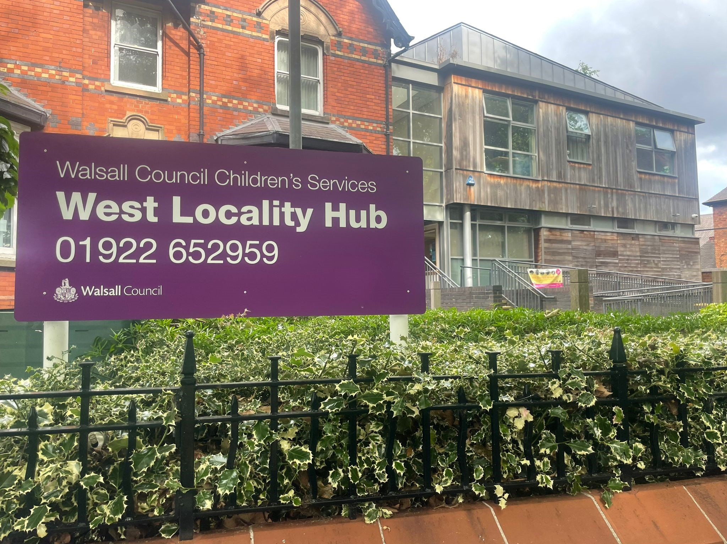
West Activity Timetable for 0 – 5 years
Serving; Willenhall North & Willenhall South, Bentley & Darlaston North, Darlaston South.
October – December 2024
** Always contact groups before attending in case of any changes
Monday | Tuesday | Wednesday | Thursday | Friday | Saturday
9.15 – 11.15am Baby & Toddler Group @ The Salvation Army, The Leys, Darlaston, WS10 8DP - 90p for adults / 70p children per session, No booking required (0-4 yrs) First Aid Awareness Workshop @ Moxley People's Centre, 3 Queen St, Moxley, Wednesbury WS10 8TA. To book your place you can email familyhubs@walsall.gov.uk ​with your name, what session you would like to book, ​your postcode and email address​ (Monday 7th October) 10.00-11.00am PEEP @ West family hub, Ilmington House, Crescent Road, Wednesbury, WS10 8AE. Please email familyhubs@walsall.gov.uk to book your place (11th, 18th, 25th November) | 9.15 – 11.15am Baby & Toddler Group @ The Salvation Army, The Leys, Darlaston, WS10 8DP - 90p for adults / 70p children per session, No booking required (0-4 yrs) 12.30 – 2.30pm Tiny Tearaways Stay & Play @ Willenhall Chart Centre, Gomer Street, Willenhall, WV13 2NS - £2 per child, No booking required (0-5yrs) 2.00-3.00pm Parent Panel Dads Drop in. Calling all male caregivers we want to hear your experience of parenting in Walsall. Come along and share your views, enjoy Free refreshments and have a chat with others. No need to book just drop in. (Tuesday 5th November) 11.00-12.00pm Grandparents Coffee and Chat @ Moxley People's Centre, Queen St, Moxley, Wednesbury WS10 8TA (1st October) 09:30am – Introducing solid foods to your baby @ West Family Hub. To book email familyhubs@walsall.gov.uk | 09.00 – 5.00pm Birth Registration @ West Family Hub, WS10 8AE To book Register a birth | Walsall Council 9.15 – 11.15am Baby & Toddler Group @ The Salvation Army, The Leys, Darlaston, WS10 8DP - 90p for adults / 70p children per session, No booking required (0-4 yrs) 9.30-11.30am Frankie's Parents and Tots @ The Hive Community Hub, The Square, Lichfield Road, New Invention, Willenhall, WV12 5EA- £1 per child, No booking required (0-3 years) 10:00am Storytime & Craft @ Willenhall Library, 1 Walsall St, Willenhall WV13 2EX – Free, please call 01922 650771 to book your place. 09:00-12:00pm Parent & Toddler group @Church on The Corner, 1 King Charles Avenue, Bentley WS2 0DL, No booking just come along, £1 per child 10:00 – 12:00pm Hive Parent and Tots @ The Hive Community Hub, The Square, Lichfield Road, New Invention, WV12 5EA – No booking 9.30-11.00am Henry (0-5yrs) @ Willenhall Chart Centre, 19 Gomer St, Willenhall WV13 2NS (9th,16th,23rd October, 6th,13th,20th,27th October) | 10:00am Storytots @ Willenhall Library, 1 Walsall St, Willenhall WV13 2EX – Free, No booking required 09:30 – 2.30pm Walsall Works drop in for families @ West Family Hub First Aid Awareness Workshop @ Willenhall Chart Centre, 19 Gomer St, Willenhall WV13 2NS. To book your place you can email familyhubs@walsall.gov.uk ​with your name, what session you would like to book, ​your postcode and email address​ (Thursday 5th December) 12.00-2.00pm Dads peer support group @ West Family Hub. No booking required, just turn up. (17th and 31st October) 9.30-11.30am 0-2 yrs parent and toddler wellbeing sessions @ West Family hub. No booking required (starting the 7th November) 10:00 -11.30am Halloween Event @ West Family Hub. Booking welcome by calling the Family Hub on 01922 654545 or simply join us on the day. (Thursday 31 October) 3:30- 17:00 Christmas Event @ West Family Hub. Join us to celebrate Christmas.. Booking welcome by calling the Family Hub on 01922 654545 or simply join us on the day. (Thursday 12 December) | 09:00-12:00pm Parent & Toddler group @Church on The Corner, 1 King Charles Avenue, Bentley WS2 0DL, No booking just come along, £1 per child | 10.30-12.00pm Stay and Play @ West Family Hub. Booking welcome by calling the Family Hub on 01922 654545 or simply join us on the day. (14th December) 10.00am-12.00pm Dads Stay and Plays @ West Family Hub No booking required, just turn up. (12th October & 9th November)
Key – Purple - funded by Walsall Family Hubs and located in Community spoke or West Family Ilmington House, Crescent Road, Wednesbury, WS10 8AE
Black – Signed up to Walsall Family Hubs Directory

Slide 6
Parent Panels
We are looking for new members to join our Parent Carer Panel to have your say on the services available to families in Walsall.
You can share your views through face to face meetings, virtual meetings, family fun sessions, online surveys and our facebook page.
In return for your support we can offer you training opportunities, volunteering opportunities, free family fun sessions among other incentives. We can also support with transport, translation services and childcare whilst you attend the face to face forums
Chill & Chat
Stay and Play with your child, meet other parents, share experiences and relax in a safe and friendly environment
Parenting my way
Come and learn about how your own childhood can affect how you parent yourself. Discussions around keeping your child safe and looking after yourself, pregnancy and birth.
Peep
Fun and creative workshops for parents to help them find out the little things they can do to make a big difference to their child’s development.
Antenatal Peep
Bring your baby along to our fun interactive story time sessions and enjoy our range of storytelling, sensory toys and nursery rhymes. Play along to our songs and meet the Family Wellbeing Champions along the way.
Let’s Talk Relationships
Look at how to communicate better in order to resolve issues whether you and your partner are together or not.
Henry
We will help you make small, impactful changes to achieve your healthy lifestyle goals. by focusing on practical behaviour changes, new parenting skills, and valuable information about nutritious food and fun activities for your children.
Saturday Stay & Plays
Come along and join our Early Years Team on a Saturday for a range of free stay and plays for children aged 0-5 years.
Introduction to solid foods
Do you have a baby around 6 months old? Would you like more information on how to introduce solid foods to your baby? You can come along to our Family Hubs where a member of the infant feeding service will be available to answer any questions and support you through this exciting stage in your baby’s feeding journey. You will also get a goodie bag!
Dad’s Stay & Plays
Dads come along meet other Dads ask any parenting questions you might have with our parenting officer and allow your children to have fun with others
Grandparents coffee & Chat
Are you a Grandparent who finds parenting has changed and hard to fathom out. Come along and learn about routines, teenager issues and how to be the best Grandparent
Dad’s Peer support group
If you’re looking for other like minded Dads to meet in a safe and friendly environment come along to our groups. Make new friends and help each others like you.
Don’t Slam the Door
Parenting a teenager can be daunting. Come to these sessions learn about the difficulties and complexities of looking after a teen

